Slide 1
BOY

Slide 2
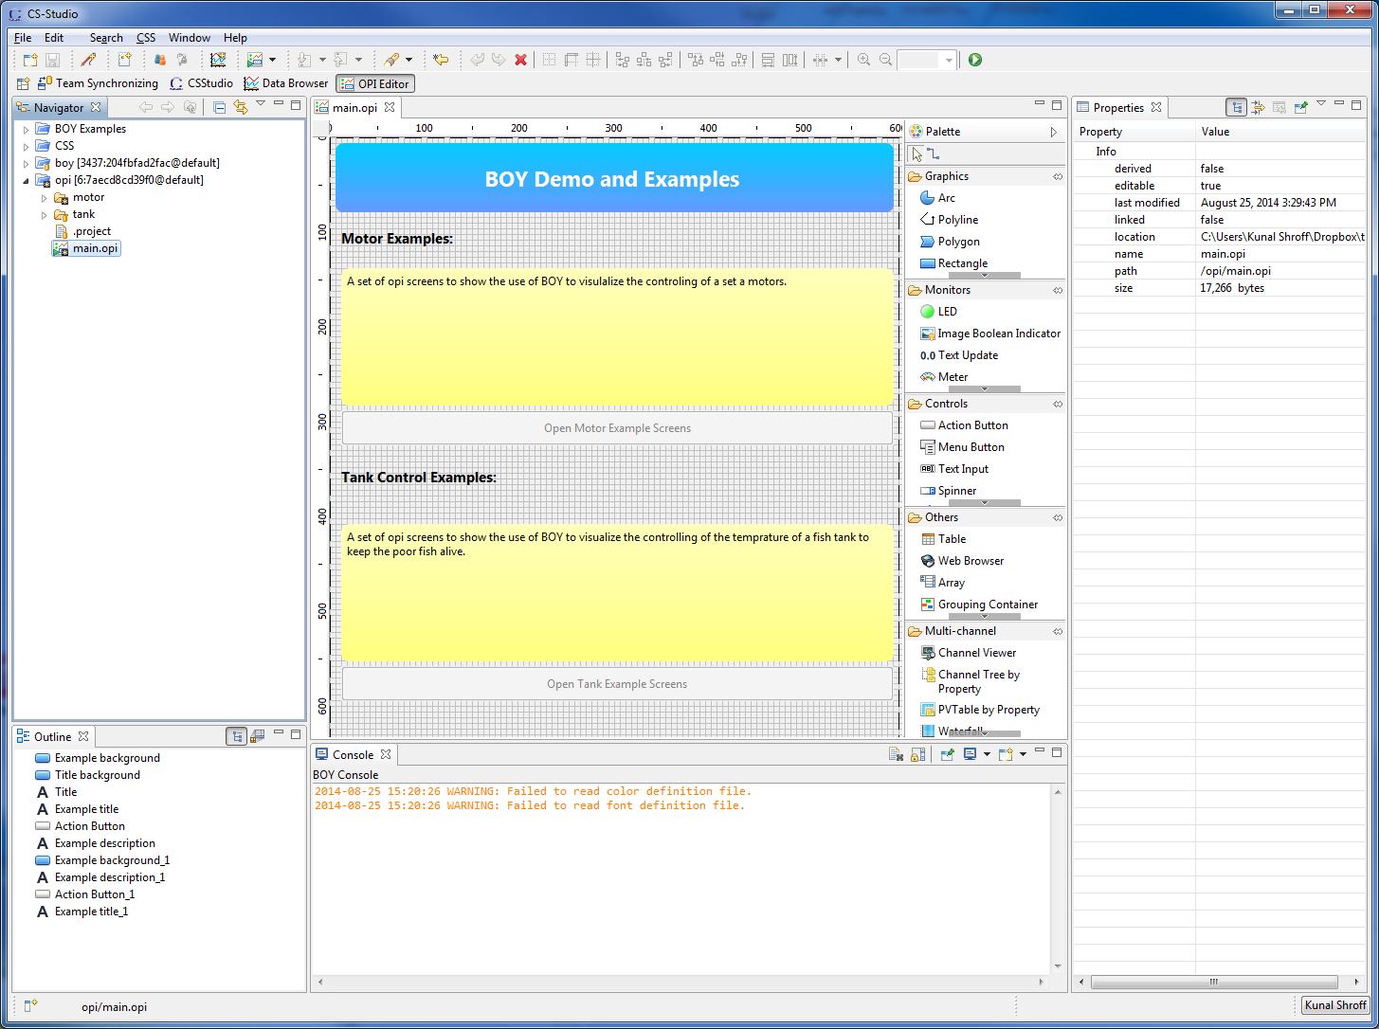
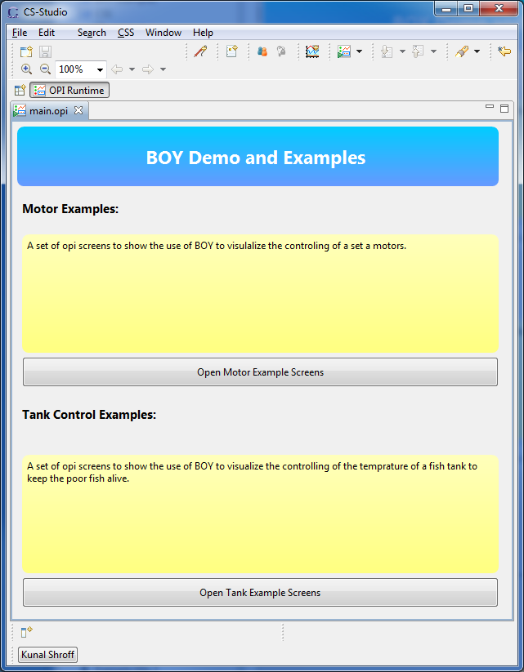
OPI Editor
OPI Runtime
Notes:
BOY editor and runtime

Slide 3
BOY Runtime

Slide 4
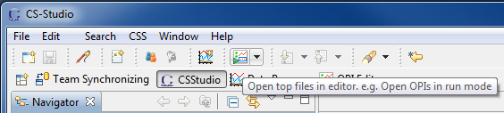
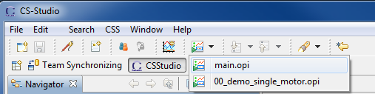
Running your OPI screen
Toolbar → Open top files
Opens the 1st top opi defined in the preferences
Usually this can be configured to the main overview page
Toolbar → Open top files dropdown
List various top level opi’s
Example: Beamline Status Page, Storage Ring Overview Page
Notes:
Launching the main screen from tool bar – main set of examples
Explore the drop down
Main, Motor_main, tank_main

Slide 5
OPI Runtime: Perspective
An Environment to run user interfaces files which connect to the various systems (controls system, ..)
Minimum clutter
No additional views
Toolbar consists of navigation, scaling and debugging buttons
Compact mode
Even less clutter; no toolbar, perspective bar, status bar…
Enter/Exit compact mode using
Hot key (F8)
Context menu (right click → compact mode)
Notes:
Switch to runtime perspective
Explain Runtime perspective – no views, minimize clutter

Slide 6
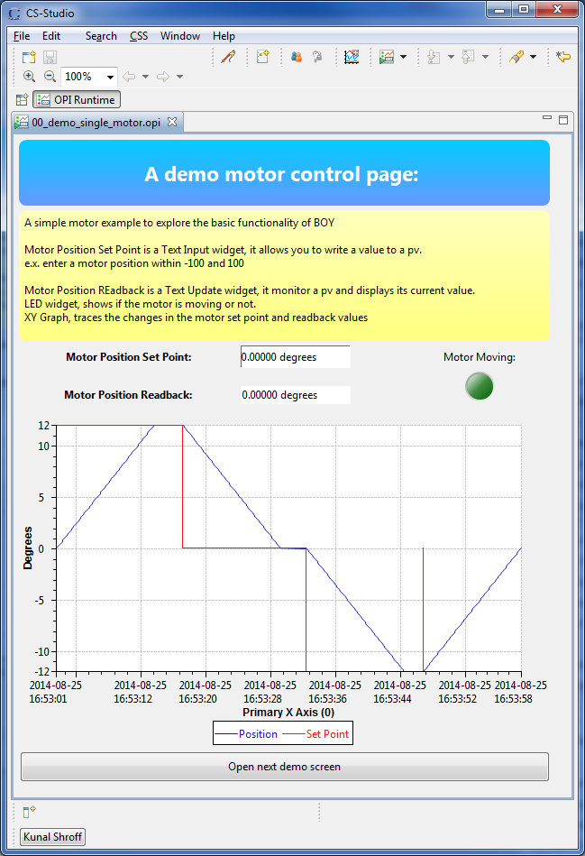
First Demo OPI screen
The screen allows you to enter a new position(in degrees) for the motor and then tracks the motor movement using various widgets.
Input PVs
Motor Position Set Point
Monitor PVs
Motor Position Readback
Motor Moving LED
XY graph
Notes:
Open Motor page 1:
Explain the basic widgets here
Have users change the pv set point

Slide 7

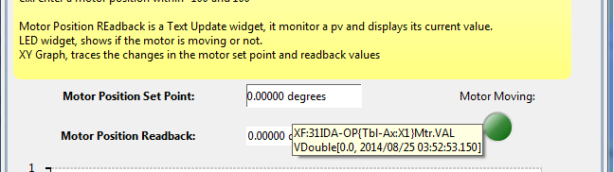
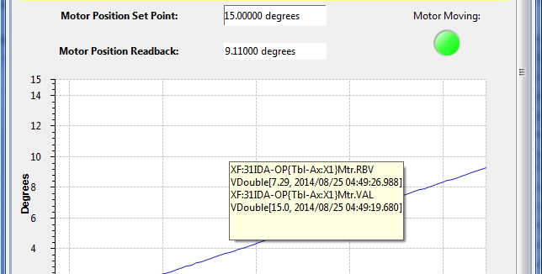
OPI Runtime: Tooltip
Status summary, Brief descriptions, Hints
“live” widget: PV value, PV connection status, Alarm information
Action / Menu button: Description of action to be performed
OPI screen tile: the complete file path

Slide 8
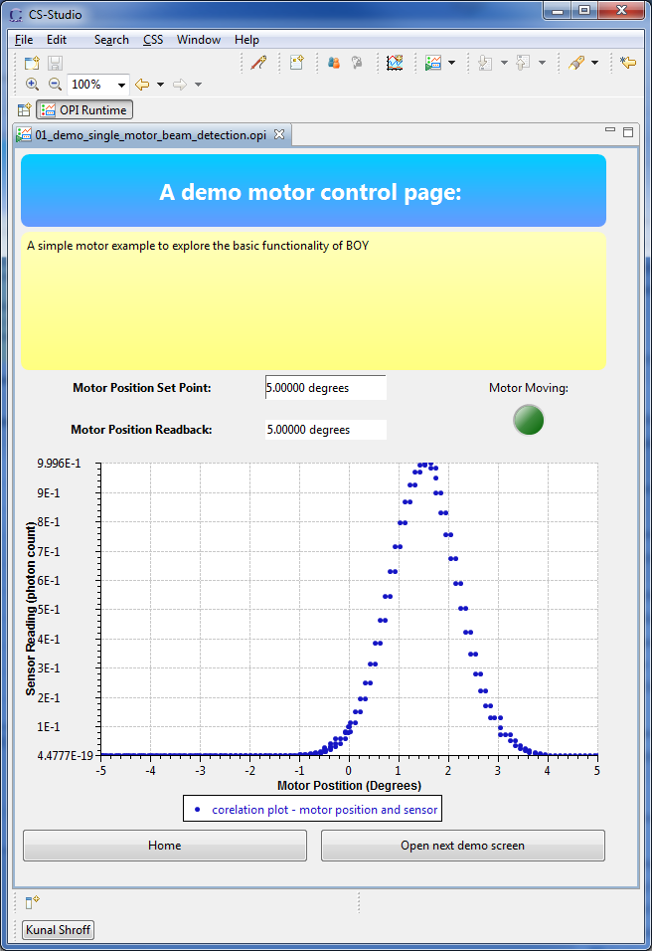
Second Demo OPI screen
Moving the motor between -5 and 5 degrees while plotting the co-relation with sensor reading allows determining the location of the peak.
Navigation
Navigation buttons: Home, Next
Navigation bar:
Hot Keys: Alt + left, Alt + right
Notes:
Navigation
Button click -> open new
Navigation toolbar to go back and forth.
Context Menu:
Open
Open in new view
Open in new window
Keys:
Ctrl + click : new view
Shift + click : new window

Slide 9
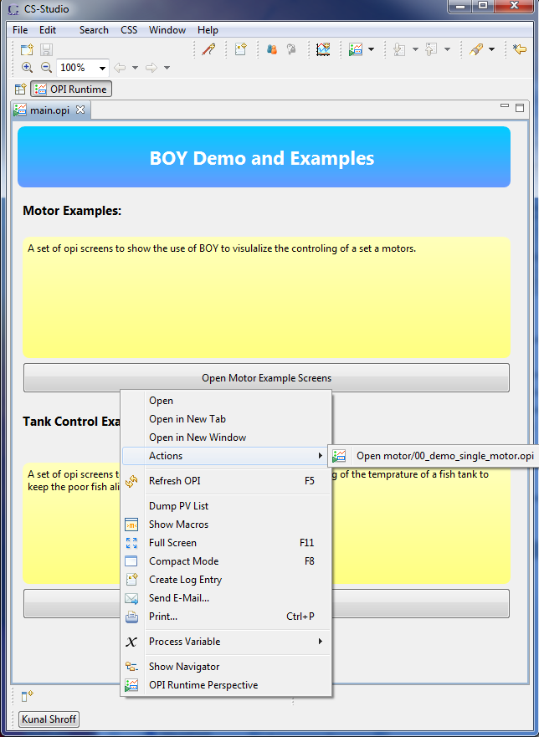
OPI Runtime: Context Menu
To open the context menu Right Click anywhere on the screen
The context menu consists of a list of actions and information based on where you have clicked
e.g.
Right click on the “Open Motor Example Screen” button, shows a context menu which lists the actions associated with this button under “Actions”.
Right click anywhere other than the button and the context menu does not contain the “Actions” or the Open * commands
Notes:
Tooltip and right click
Mouse over,
tooltip will have instructions or hints on what control widgets are going to go
If active pvs, tooltips will give information about the pv associated with the widget underneath
Context menu:
Action button – list of actions
Options on where to open the screen
You will see how the context menu contains different commands based on where and what you have right clicked on

Slide 10
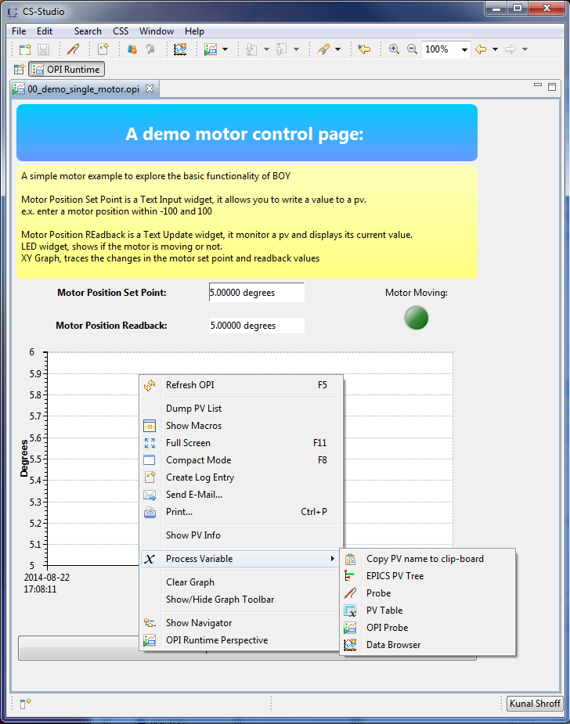
OPI Runtime: Context Menu
Context menu associated with “live” widgets
Show PV info
Process Variables menu to send these pv’s to different applications
Exercise:
Open the pvs associated with the plot in Probe
Open the pvs in Data Browser to see the historic values of these pvs
Notes:
Tooltip and right click
Mouse over,
tooltip will have instructions or hints on what control widgets are going to go
If active pvs, tooltips will give information about the pv associated with the widget underneath
Context menu:
Action button – list of actions
Options on where to open the screen
You will see how the context menu contains different commands based on where and what you have right clicked on

Slide 11
BOY Editor

Slide 12
OPI Editor: Perspective
Window →
Display →
OPI Editor Perspective
Notes:
Open BOY editor
1. menu: …. Open opi editor perspective
Explain opi editor perspective
Navigator: help to organize the files in the workspace.
Outline: provides a synoptic view of the editing OPI.
Console: display information such as error, warning or general information to user.
Properties Sheet: set properties for selected widget or common properties for multiple selected widgets

Slide 13
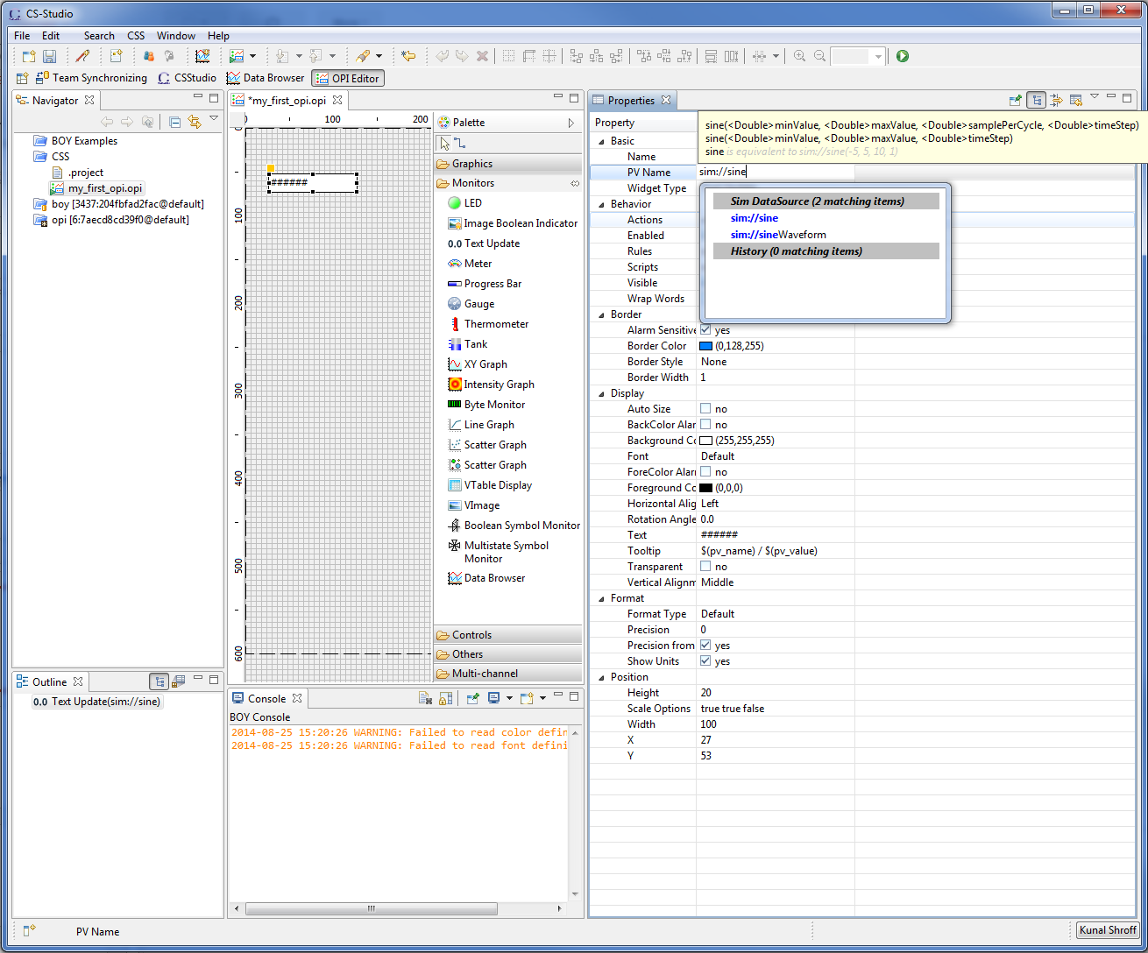
Creating your first BOY screen
File → New → BOY → OPI File
Create a new OPI File Dialog
Select the folder:
CSS
OPI File Name:
<your_name>_demo
Add a widget
Drag and drop the text update widget from the palette
Set property PV Name : sim://sine
Save the file
Notes:
In CSS project create a new opi file
A test screen – with a single text update pv
sim://sine

Slide 14
Running your first BOY screen
Toolbar : Run opi button
HotKeys: Ctrl + G
Navigator: right click on file
→ Open With
→ OPI Runtime
Notes:
In CSS project create a new opi file
A test screen – with a single text update pv
sim://sine

Slide 15
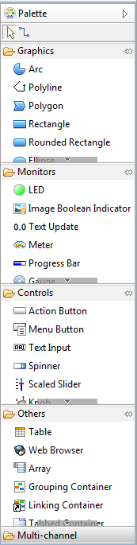
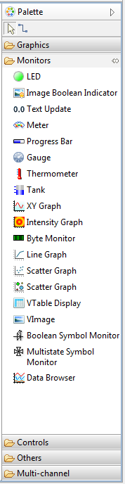
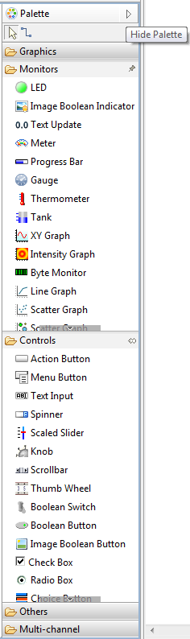
Widget Palette
Displays the available widgets grouped by behavior
Graphics
Monitor
Controls
Others
Multi-Channel
Navigating the Palette
Click section heading to minimize/maximize that section
Hide Palette
Pin the Palette (does not minimize when another section is selected)

Slide 16
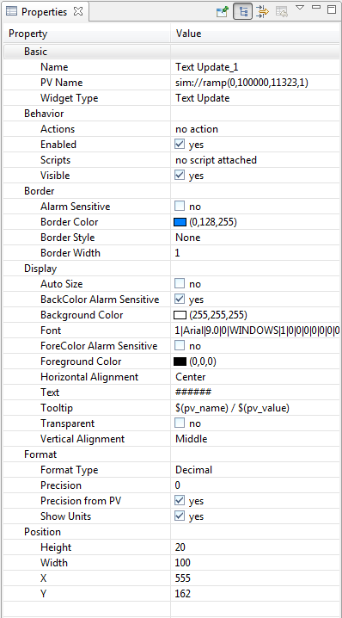
Widget Properties
Describe the visual and behavioral attributes of the widget
Help → Help Contents
CSS Applications → Display → Best OPI, Yet (BOY) → Widgets
Notes:
Widget properties
Basic configurations
Alarm
Display limits
Display
Format
Basic
Name(name). The name of the widget.
Widget Type(widget_type). The type of the widget. This property that is not editable. The name and type of the selected widget will also be displayed on the status bar.
Behavior
Actions(actions). The actions assocaited with the widget.
Enabled(enabled). A disabled control widget is not operatable.
Rules(rules). The rules attached to the widget.
Scripts(scripts). The scripts attached to the widget.
Visible(visible). Visibility of the widget.
Border
Border Color(border_color). The color of the border.
Border Style(border_style). The style of the border.
Border width(border_width). The width of the border. Only meaningful for line or dot line styles.
Display
Background Color(background_color). Color of Background.
Foreground Color(foreground_color). Color of foreground. In most cases, it is the font color too.
Tooltip(tooltip). Tooltip of the widget. Macros are allowed and can be updated when tooltip is shown again. The property macro $(pv_value) could be used to show the PV value which has timestamp, value, severity and status.
Position
Height(height). The height of the widget in pixels.
Width(width). The width of the widget in pixels.
X(x). X location coordinate in pixels. The zero point of the coordinate system is on the left-top cornor. Negative coordinate is allowed, but is not recommended.
Y(y). Y location coordinate in pixels
Scale Options (scale_options). The options to control the scale behavior of the widget.

Slide 17
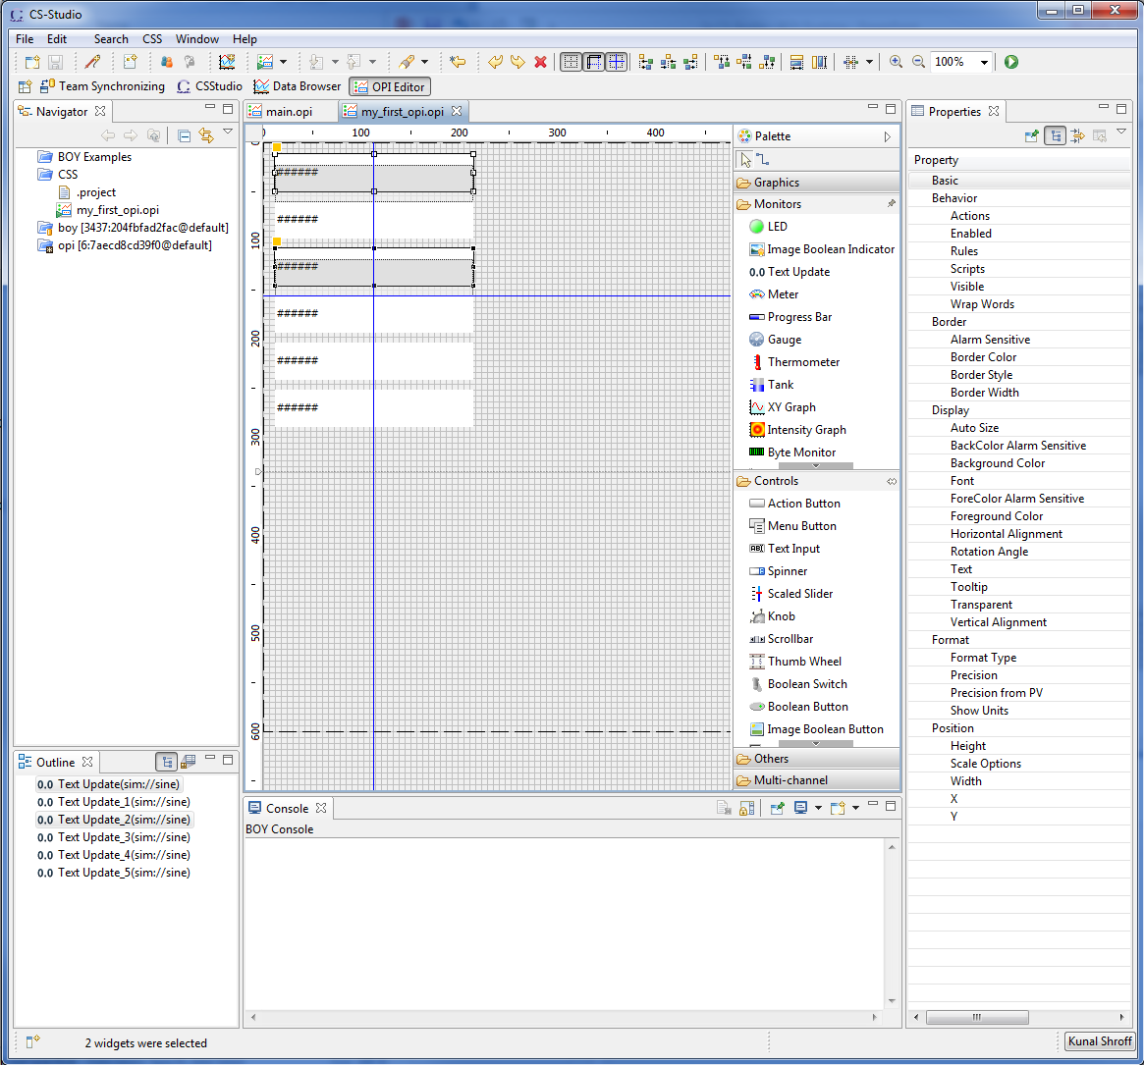
Editing Widgets
Select, Move or Resize
Clone Widgets (copy paste)
Alignment tools
Grid
Snap to Grid
Snap to Geometry (sides and sizes of other widgets)
Arrange group of widgets
Copy properties
Notes:
Create another widget,
Show alignment tools
Copy and paste properties

Slide 18
Note: location of demo
On github
https://github.com/shroffk/cs-studio-training
On train
/home/train/cs-studio-training/demo-opis

Slide 19
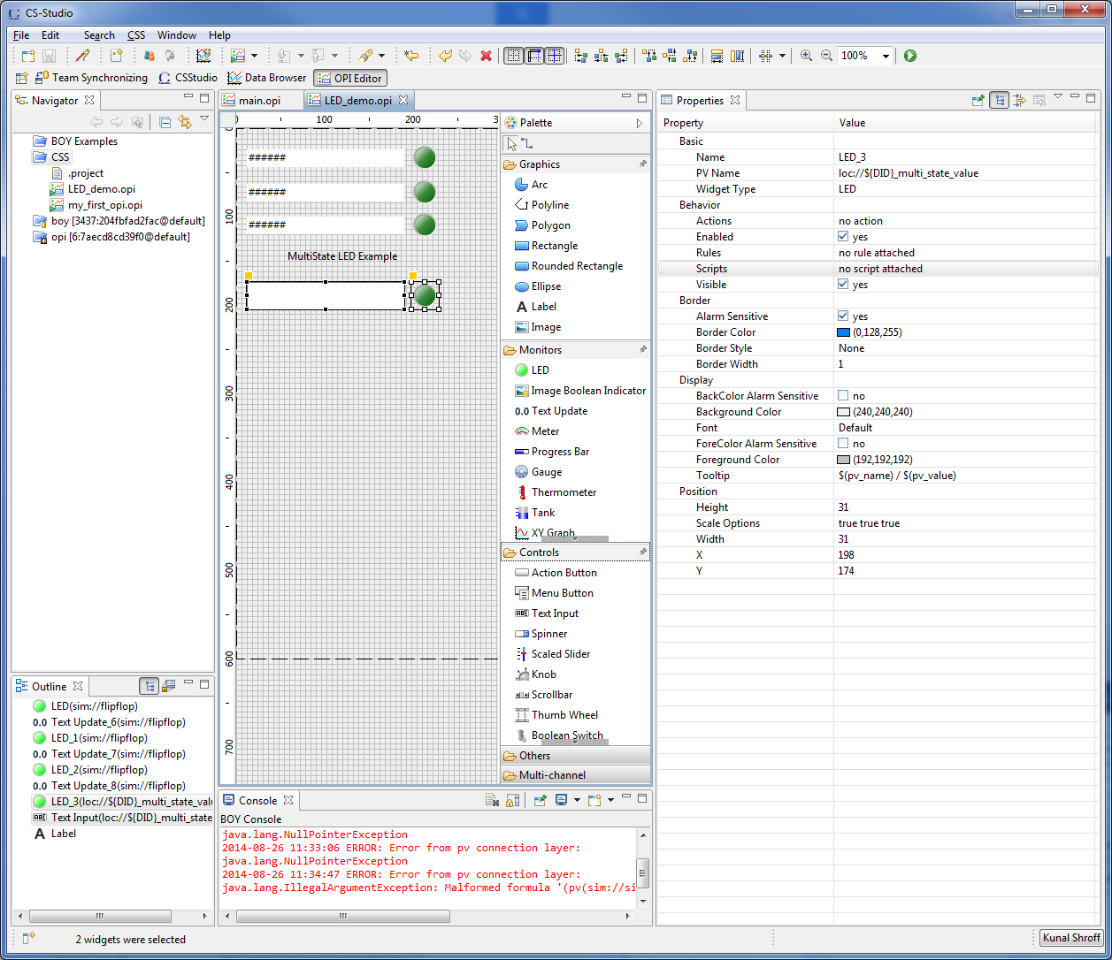
LED
Exercise:
Boolean
Create a LED widget with PV Name sim://flipflop
Copy paste the LED to Create an Array of LEDs
Copy the PV Name property from the LED to a Text Update widget
MultiState
Create a LED widget with
PV Name = loc://${DID}_multi_state_value
State Count = 4
Create a Text Input widget with
PV Name = loc://${DID}_multi_state_value
Change the value in the Text Input
Notes:
LED

Slide 20
Action Button Menu Button
An Action button widget which is used to execute an action with clicking the button
Open OPI
Write to PV
Execute Command
Play Wave file
Open File
Menu buttons provide a list of Actions
Help → Help Contents → CSS Applications → Display → BOY → Widgets → Action/Menu Button
Notes:
Actions button
Action
Actions can be attached to any widget so that actions can be executed from that widget. They are configured from the Actions Property. There are several types of actions that can be associated with any type of widget. You may also add customzied action through Eclipse plugin mechanism.
Open OPI Open a related OPI. If Repalce is selected, it will replace the current OPI. You can send macros to the OPI to be opened by setting the Macros property. If a widget has this action hooked to its mouse click event, user will also be able to open the related OPI from its context menu: Open, Open in New Tab or Open in New Window. Or user can hold the Ctrl/Shift key while clicking on the widget to open the related OPI in new Tab/Window.
Open OPI in ViewOpen an OPI in view. The view can be place in five possible positions: Left, Right, Top, Bottom or Detached. An undetached View can also be detached as standalone window floating on top by right clicking the view tab and click Detached. By clicking Detached again, you can put it back to the workbench window.
Write PV Write a PV. If the widget is a button, it is recommended to set the PV name in the "PV Name" property of the widget, and use $(pv_name) as PV Name of the action. This will allow the PV getting connected on OPI startup instead of connecting to it on each write. If Confirm Message is not empty, a confirm dialog will pop up before writing the new value to PV.
Execute Command Execute system command just as executing command from shell or command line on Windows. The command should be searchable from system PATH, otherwise, it should be a full path to the command. The output will be displayed in the console if there is. The property "Command Directory" is where the command will be executed. In most cases, you can just use the default directory which is user's home directory.
Execute JavaScriptExecute a Javascript file, in which there are two accessible objects: widget and display so that you can access the widget or the display. See Access Widget
Execute Python ScriptExecute a Python script file, in which there are two accessible objects: widget and display so that you can access the widget or the display. See Access Widget
Play WAV file Play a sound file in WAV format.
Open File Open a file with the default editor. For example, you can open a databrowser file in databrowser.
Open Webpage Open a webpage in system default web browser.

Slide 21
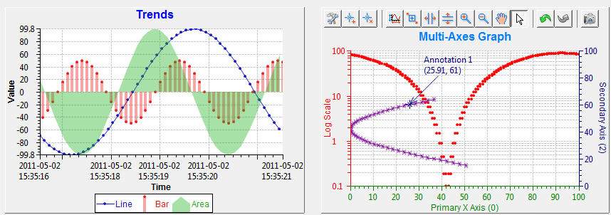
XY Graph
A widget that is able to plot 1D or 2D data in an XY Graph
Help → Help Contents → CSS Applications → Display → BOY → Widgets → XY Graph
Notes:
XY Graph

Slide 22
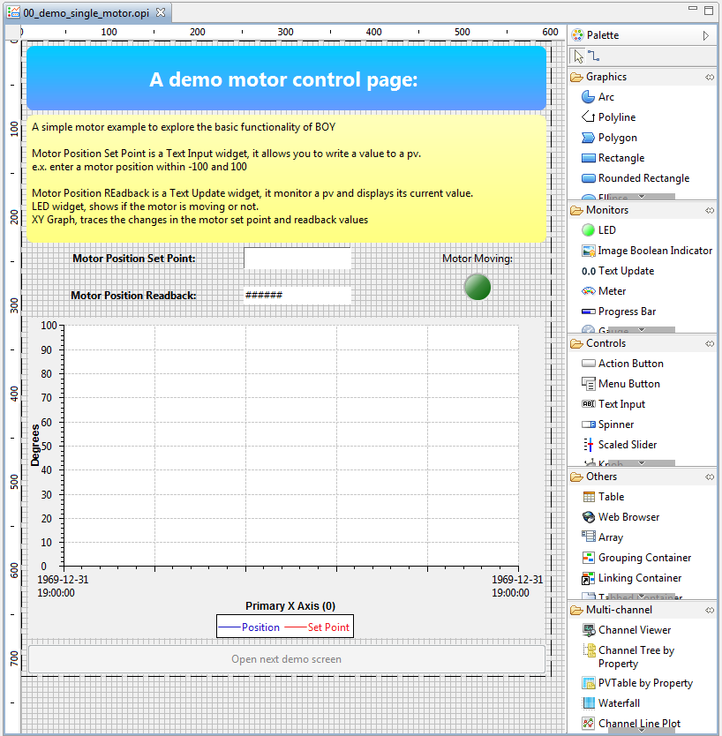
Exercise Create a simple motor control screen
A Text Input Widget (controls) for entering the set point
PV Name = XF:31IDA-OP{Tbl-Ax:X1}Mtr.VAL
A Text Update Widget (Monitor) for monitoring the readback
PV Name = XF:31IDA-OP{Tbl-Ax:X1}Mtr.RBV
A LED Widget (Monitor) to indicate the motor is moving
PV Name = XF:31IDA-OP{Tbl-Ax:X1}Mtr.MOVN
An XY graph (Monitor) to plot the changed in the motor setpoint and the motor position
Trace 0
Y PV = XF:31IDA-OP{Tbl-Ax:X1}Mtr.RBV
Trace 1
Y PV = XF:31IDA-OP{Tbl-Ax:X1}Mtr.VAL
Primary X Axis (0)
Time Format = HH:mm:ss
Notes:
Exercise: try to create the simple motor screen

Slide 23
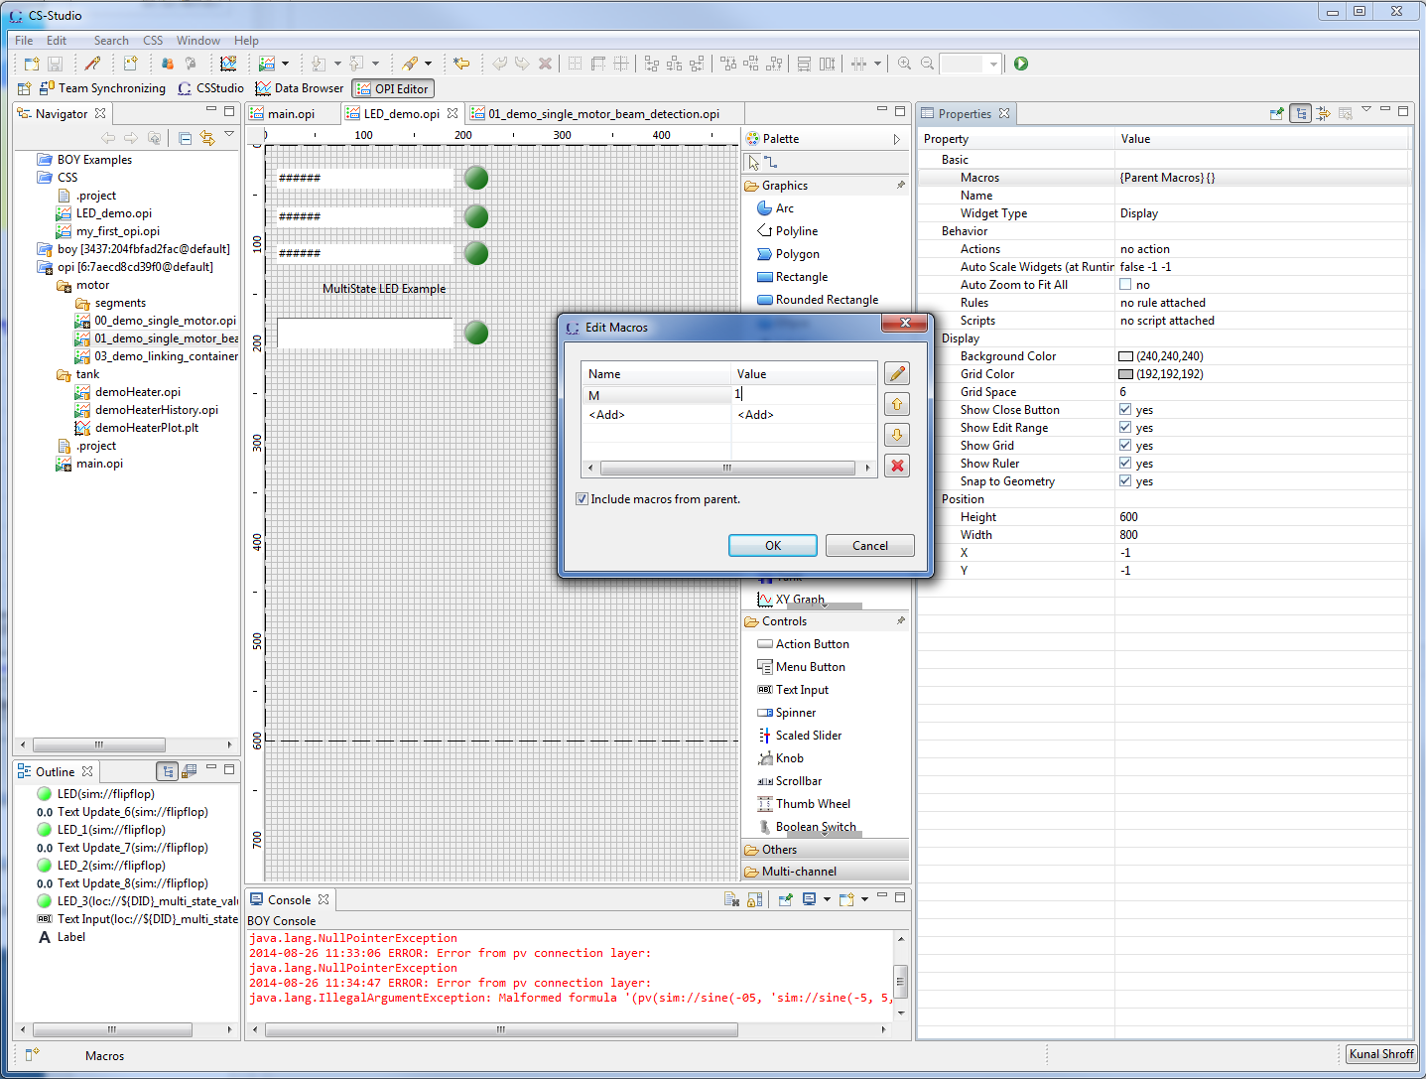
Macros
Macros are some predefined strings that can be embedded in any string based properties such as "PV Name", "Text", "Tooltip", "Rules“
Macros are resolved at runtime when the screen is loaded
e.g.
PV Name = XF:31IDA-BI{Dev: $(M)}E-I
Notes:
Macros

Slide 24
Containers
Linking container
Create composite screens by embedding different opi screens or groups.
Grouping container
Groups a set of widgets together
Notes:
Grouping container and linking containers

Slide 25
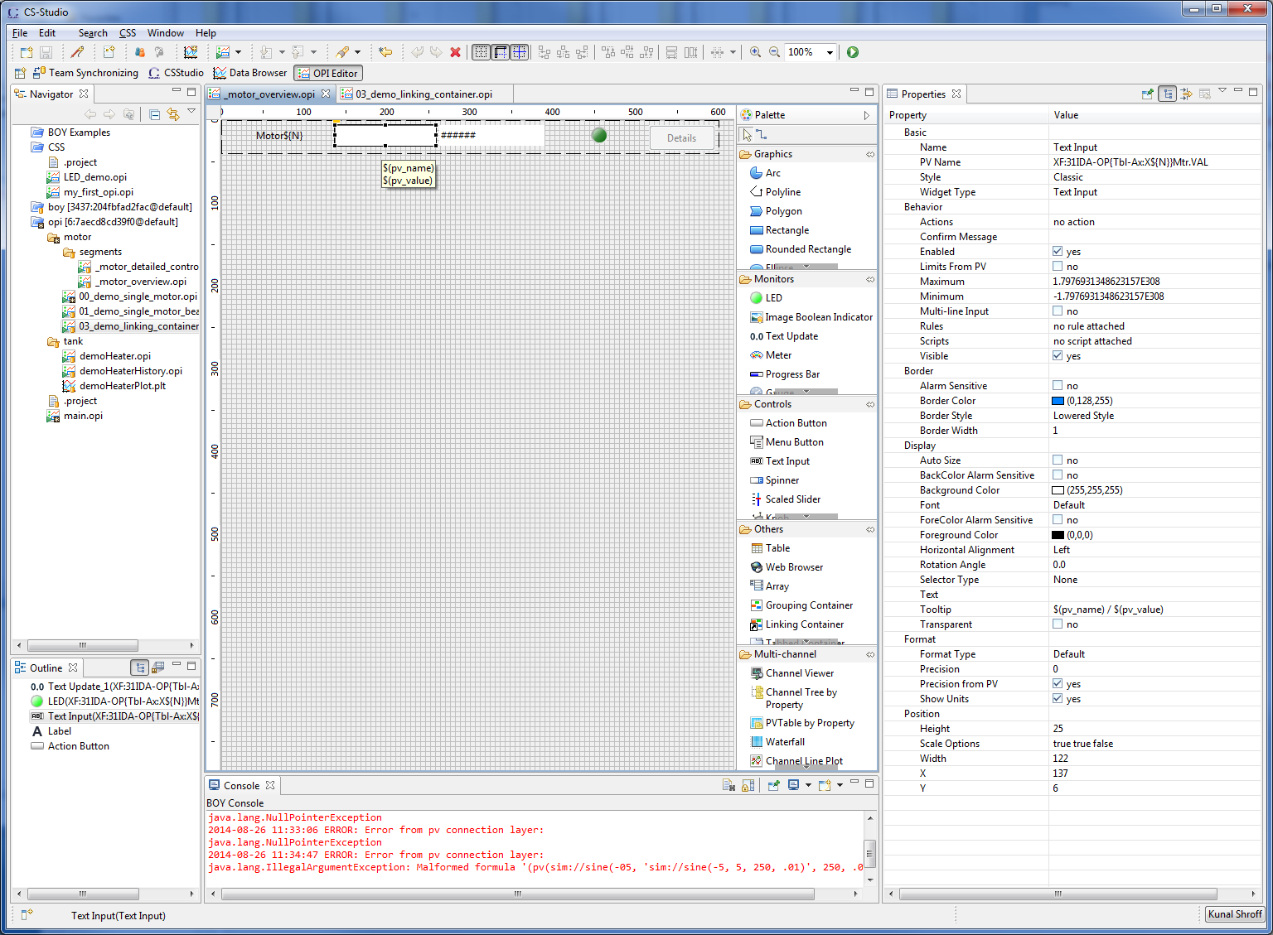
Exercise: Linking container & Macros
Create a simple screen (_motor_overview.opi) which represents a reusable segment with a
Label
Text = Motor $(N)
Text Input
PV Name = XF:31IDA-OP{Tbl-Ax:X$(N)}Mtr.VAL
Text Update
PV Name = XF:31IDA-OP{Tbl-Ax:X$(N)}Mtr.RBV
LED
PV Name = XF:31IDA-OP{Tbl-Ax:X$(N)}Mtr.MOVN

Slide 26
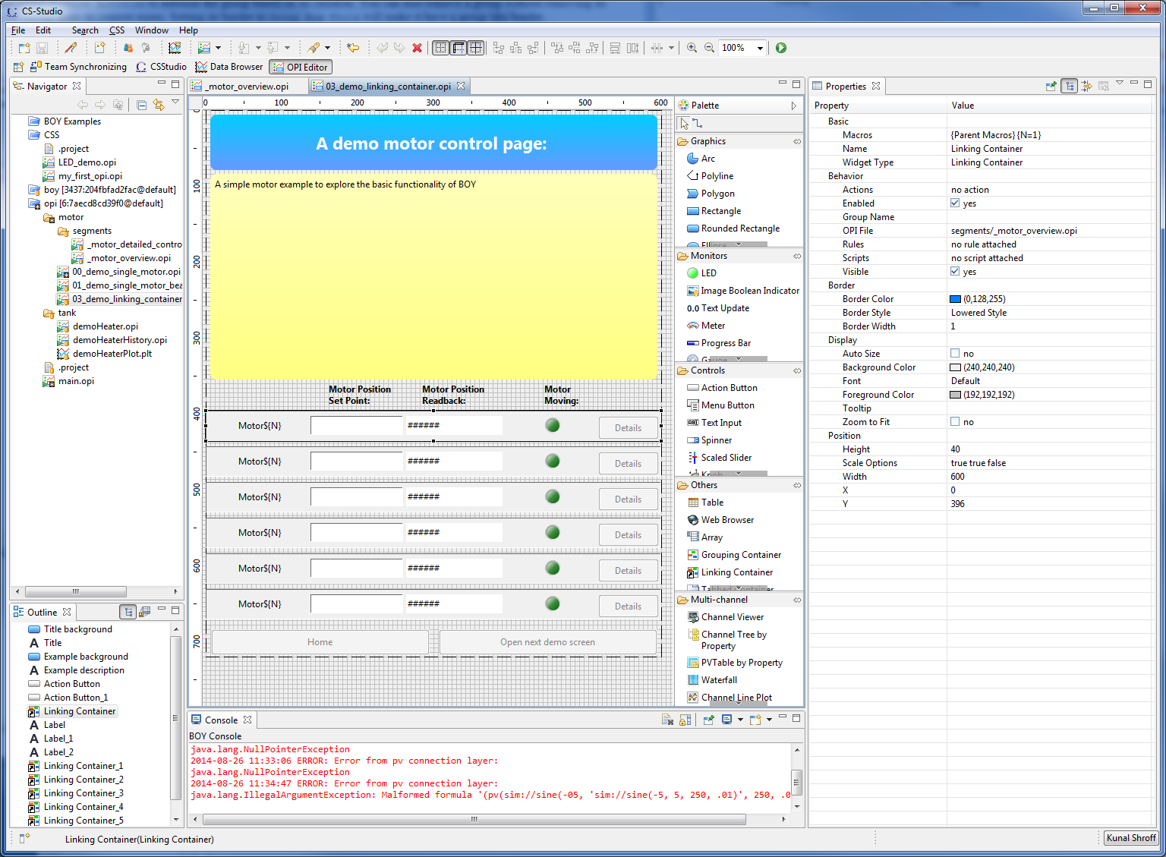
Exercise: Linking container & Macros
Create another opi screen with 6 Linking container
OPI File = Path to _motor_overview.opi
Macros = for each linking container set N = 1, 2,…6

Slide 27
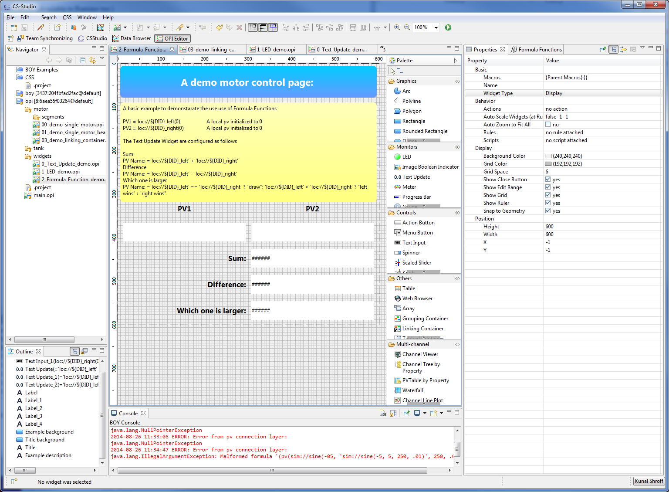
Exercise: Formula Functions
CS-Studio→ Debugging → Formula Functions
A useful tool for doing some basic operations on your process variable values
They start with a “=“
Process Variables are enclose in “ ’ ”
Notes:
Formula functions
Exercise: left wins or right wins

